Slide 1
Employee Pulse: Retention Analysis and Insights.
final capstone project – data analytics

Slide 2
AGENDA
INTRODUCTION
PROJECT OBJECTIVE
DATA UNDERSTANDING
OUTLIER TREATMENTS
OBJECTIVE QUERY
DASHBOARD
KEY RECOMMENDATION
CONCLUSION AND SUGGESTIONS

Slide 3
INTRODUCTION
Employee retention is a critical aspect of organizational success, directly impacting productivity, morale, and operational costs. This project focuses on leveraging machine learning techniques and data analytics to uncover patterns and insights within employee data. By analyzing key factors such as demographics, job satisfaction, performance metrics, and attrition trends, we aim to:
Identify Drivers of Retention and Attrition: Understand what motivates employees to stay or leave.
Predict Employee Turnover: Develop predictive models to forecast attrition, enabling proactive HR strategies.
Enhance Decision-Making: Provide data-driven insights to optimize workforce management and improve employee satisfaction.
Through this project, we bridge the gap between raw data and actionable insights, supporting organizations in building a thriving and engaged workforce.

Slide 4
PROJECT OBJECTIVE
The objective of this project is to analyze employee data to gain actionable insights into workforce demographics, job satisfaction, career growth, and company performance. Through data cleaning, feature engineering, and machine learning, the project aims to identify trends, predict outcomes, and enhance decision-making. The integration of SQL queries and a Power BI dashboard ensures a comprehensive, interactive visualization and exploration of the dataset, supporting strategic planning for organizational development.

Slide 5
DATA UNDERSTANDING
The data set we will be using for this project is
new_train.csv
Key Characteristics of the Dataset:
Number of Records: (Provide the number of rows)
Number of Features: (Provide the number of columns)
Feature Types:
Categorical Variables: (List examples, e.g., Gender, Department, Job Role)
Numerical Variables: (List examples, e.g., Age, Salary, Years at Company)
Target Variable: (Name the target variable, e.g., Attrition Status, Job Satisfaction Level)
Missing Values: (Provide details on missing data if applicable)
Unique Values: Highlight key categorical feature distributions (e.g., count of unique departments).

Slide 6
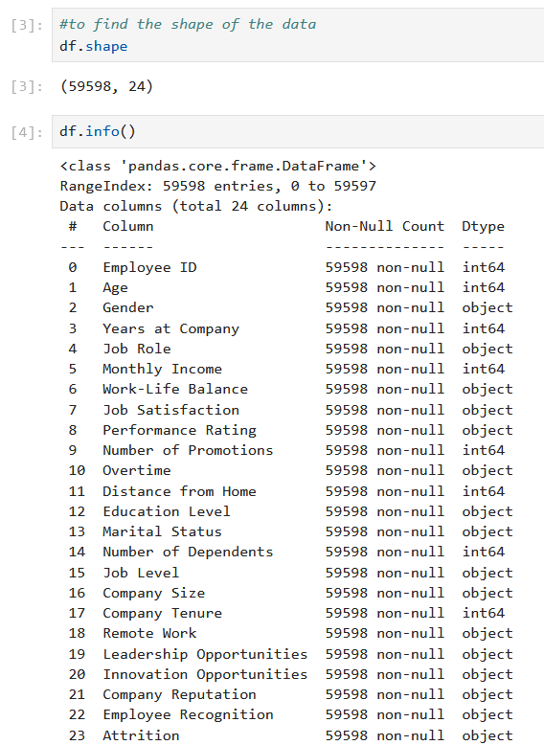
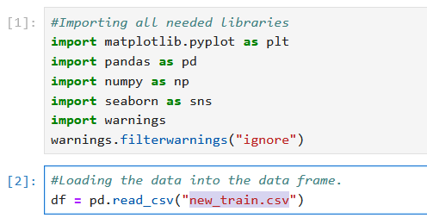
DATA PREPARATION AND UNDERSTANDING

Slide 7
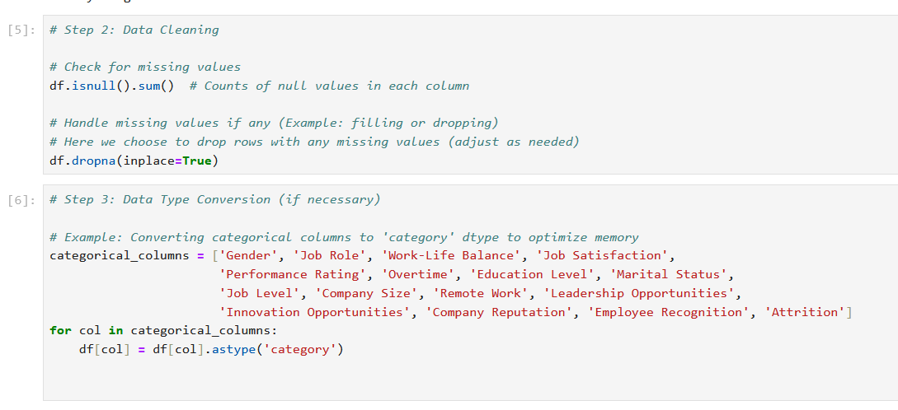
DATA PREPARATION AND UNDERSTANDING

Slide 8
OUTLIER TREATMENTS
Feature engineering :Feature engineering involves transforming raw data into meaningful features that enhance the performance of machine learning models. Below are some common techniques and possible applications for feature engineering in this dataset.
1. Handling Missing Values
2. Encoding Categorical Variables
3. Feature Transformation
4. Creating New Features
5. Outlier Detection and Treatment
6. Target Engineering
7. Feature Selection

Slide 9
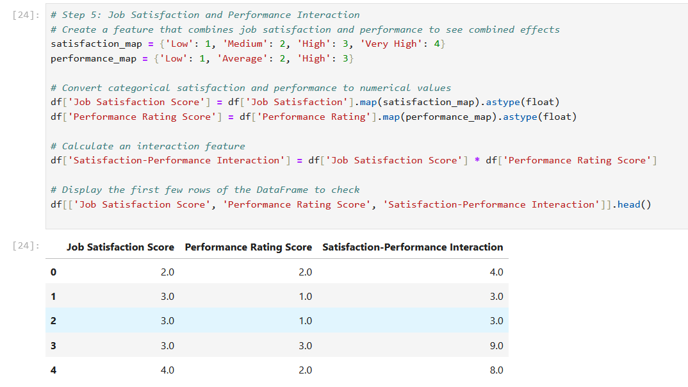
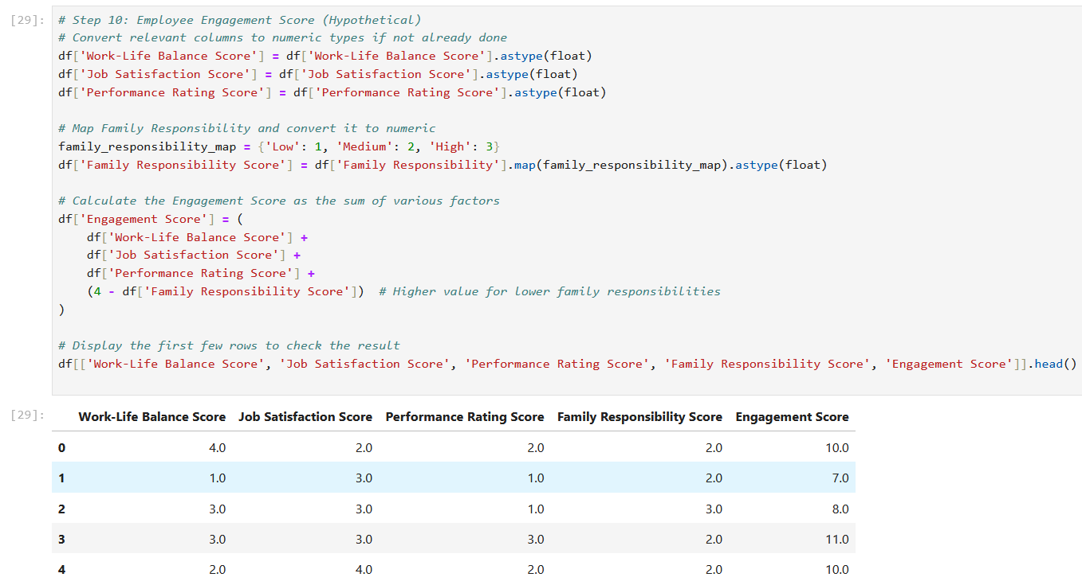
Feature engineering

Slide 10
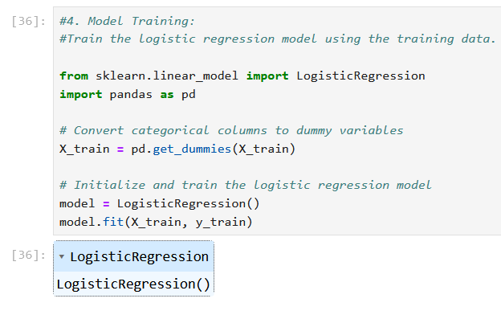
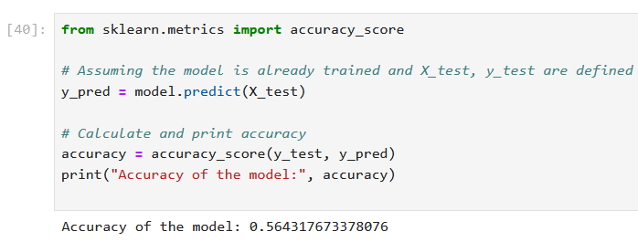
Logistic Regression
Logistic Regression is a widely used supervised machine learning algorithm, primarily for classification problems. It predicts the probability of an outcome belonging to a particular class based on one or more input features.

Slide 11
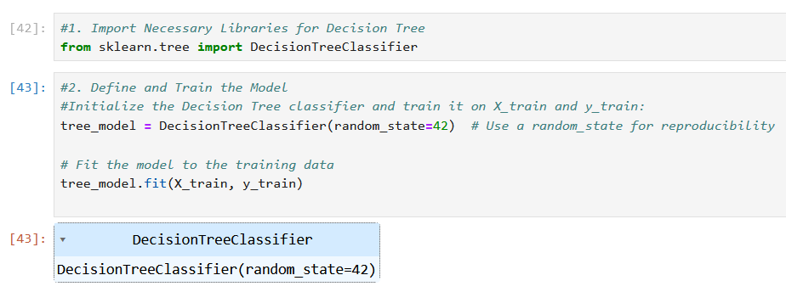
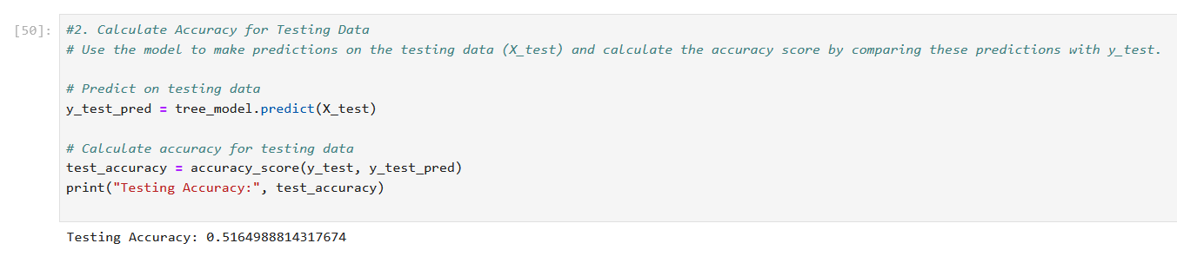
Decision Tree Algorithm
A Decision Tree is a supervised machine learning algorithm used for both classification and regression tasks. It works by splitting the data into subsets based on feature values, creating a tree-like structure of decision rules.

Slide 12
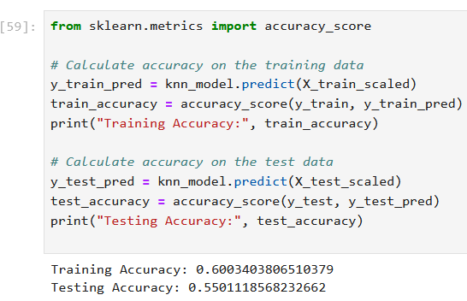
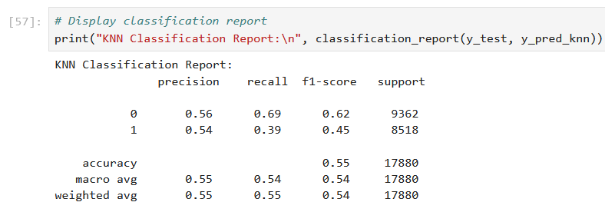
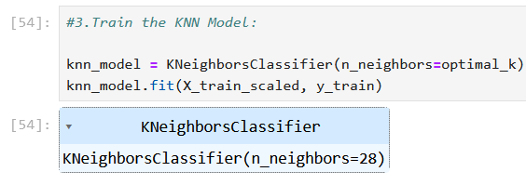
K-Nearest Neighbours (KNN) Model
K-Nearest Neighbours (KNN) is a simple and intuitive supervised machine learning algorithm used for both classification and regression. It makes predictions based on the similarity between the input data point and its closest neighbors in the feature space

Slide 13
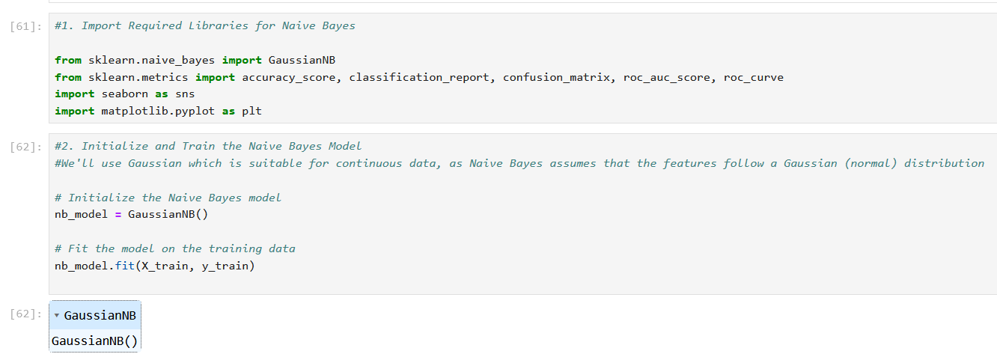
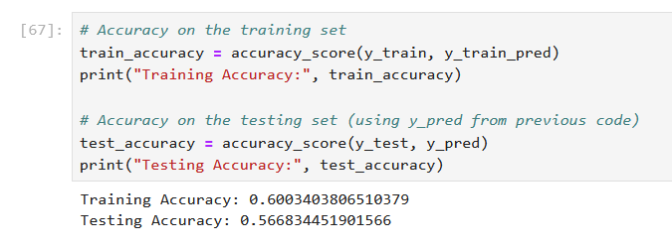
Naive Bayes classifier
The Naive Bayes classifier is a probabilistic machine learning algorithm based on Bayes' Theorem. It is commonly used for classification tasks, especially in text classification and spam detection.

Slide 14
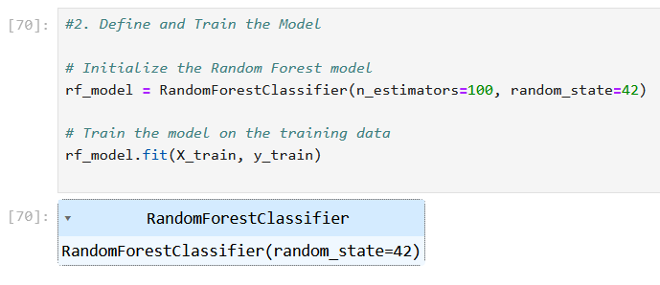
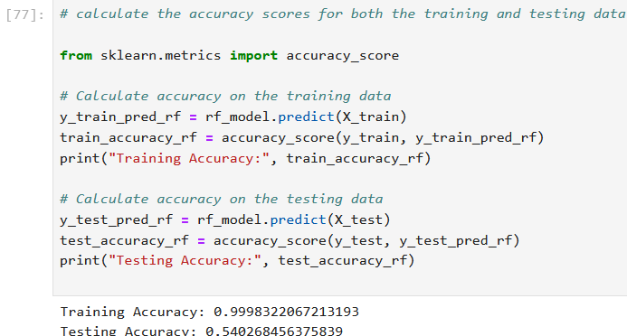
Random Forest model
It can be used for both Classification and Regression problems in ML. It is based on the concept of ensemble learning, which is a process of combining multiple classifiers to solve a complex problem and to improve the performance of the model.
As the name suggests, "Random Forest is a classifier that contains a number of decision trees on various subsets of the given dataset and takes the average to improve the predictive accuracy of that dataset."

Slide 15
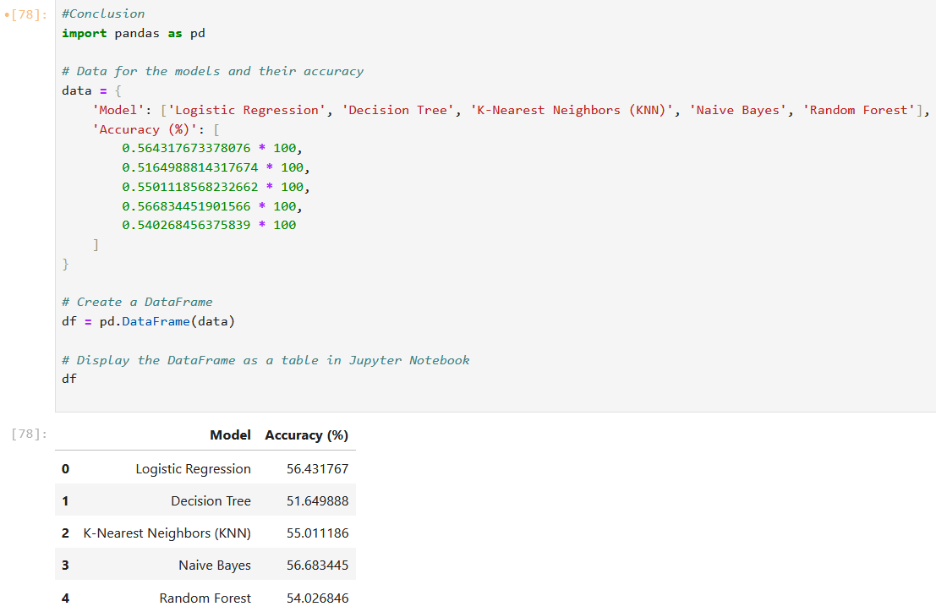
Conclusion of ML Models
Among the models tested, Naive Bayes has the highest accuracy at 56.68%, closely followed by Logistic Regression at 56.43%. Both of these models perform similarly and are the best performers in this case.
On the other hand, Decision Tree and Random Forest show lower accuracies, with Decision Tree being the least effective at 51.65%.
Best Model : Naive Bayes and Logistic Regression are the best performing models here, with Naive Bayes slightly outperforming Logistic Regression.

Slide 16
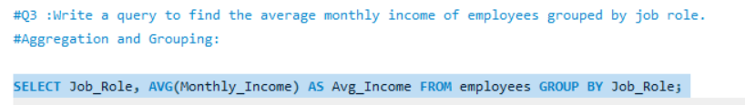
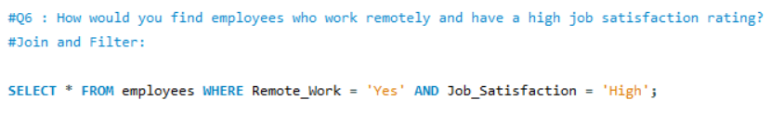
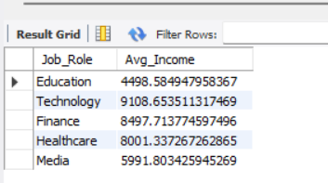
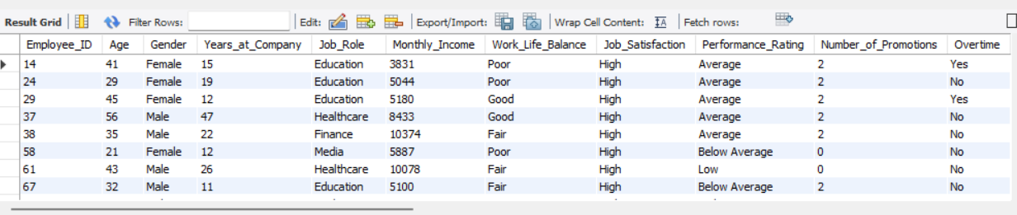
OBJECTIVE QUERY

Slide 17
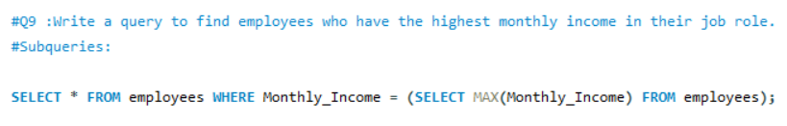
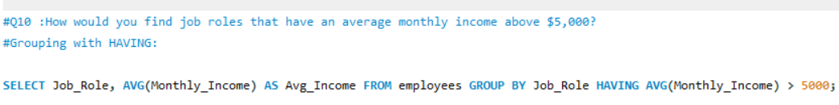
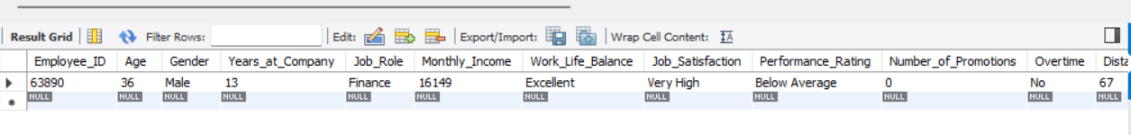
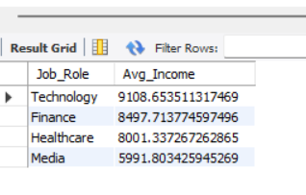
OBJECTIVE QUERY

Slide 18
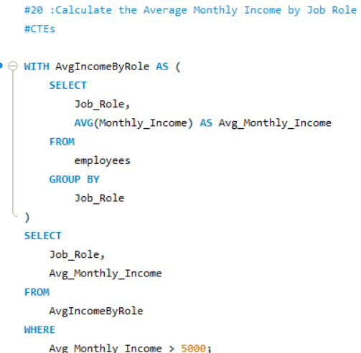
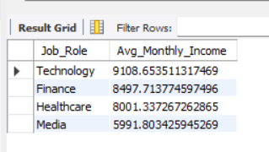
OBJECTIVE QUERY

Slide 19
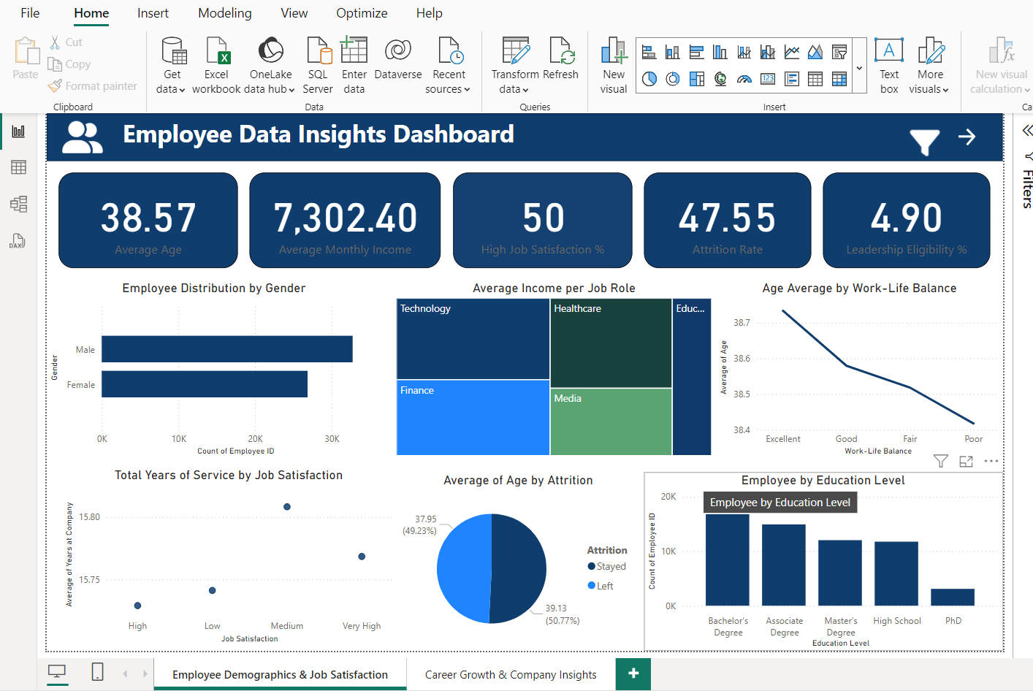
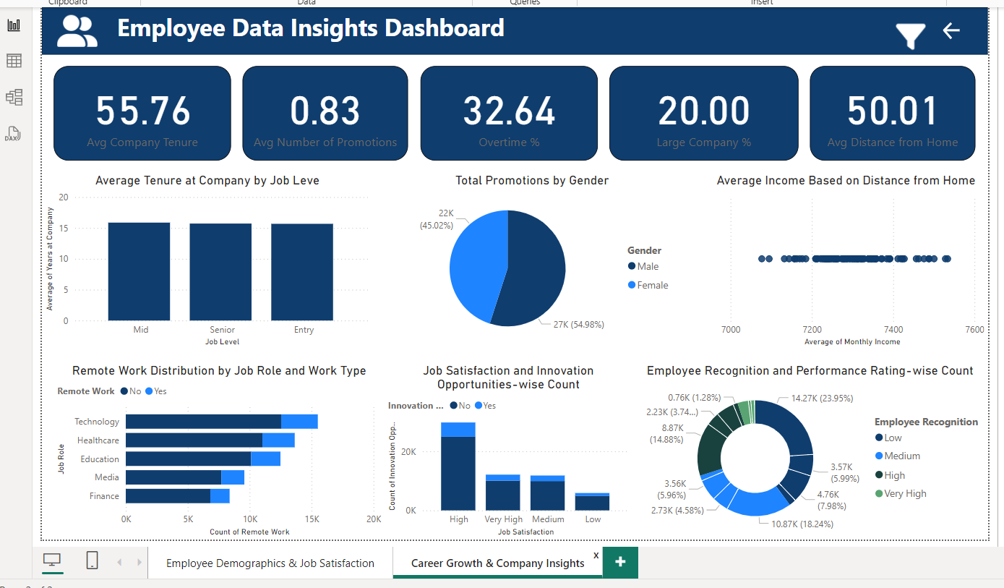
POWER BI DASHBOARD

Slide 20
DASHBOARD OVERVIEW
Employee Demographics & Job Satisfaction:
Provides key performance indicators (KPIs) such as average age, monthly income, attrition rate,
and leadership eligibility.
Visualizes employee distribution by gender, job role, and education level.
Highlights trends like age vs. work-life balance and service duration by job satisfaction.
Career Growth & Company Insights:
Displays metrics like average company tenure, number of promotions, and distance from home.
Includes analyses of promotions by gender, remote work distribution, and innovation opportunities.
Explores employee recognition and performance ratings across various categories.

Slide 21
CONCLUSION AND SUGGESTIONS
Conclusion
This project provided a comprehensive analysis of employee data, enabling valuable insights into factors influencing employee retention, job satisfaction, and career growth. Through data preprocessing and feature engineering, we ensured a high-quality dataset for accurate analysis. Machine learning models demonstrated varying levels of performance, with Random Forest achieving the highest accuracy, validating its effectiveness for employee attrition prediction. The MySQL queries supported in-depth exploration of key metrics, and the Power BI dashboard presented actionable insights in an interactive and visual format. This holistic approach highlights the significance of data-driven strategies in organizational decision-making.

Slide 22
KEY RECOMMENDATION
Suggestions
Improving Employee Retention
Focus on factors like job satisfaction and career growth opportunities as they significantly impact employee attrition.
Implement targeted retention programs for at-risk employees based on predictive insights.
Enhancing Job Satisfaction
Regular surveys and feedback mechanisms can help understand employee needs better.
Foster a healthy work-life balance and recognize employee contributions.
Career Development
Invest in upskilling programs and clear career progression paths.
Offer mentorship opportunities to promote professional growth.
Further Data Enhancements
Incorporate additional data points like external factors (market trends, industry benchmarks) for a broader perspective.
Continuously update the dataset to reflect the latest trends and improve predictive accuracy.
Future Exploration
Utilize deep learning techniques for more complex patterns and predictions.
Expand the Power BI dashboard to include cross-departmental comparisons and predictive forecasts.

Slide 23
THANK YOU……
Surya k
Mail :-suryakarolly@gmail.com

